Slide 1

Genomic data classification
Presented by : Roei Michael and Bar Daabul

Slide 2

Motivation
We are doing a research project in order to enable life-saving real time classification and diagnostics of pathogens.
The genomic data has an impact on various fields such as medicine, genetics, and biotechnology. In the field of medicine, the identification of pathogens is very important to make life-saving decisions.
There are some challenges in analyzing and classifying genomic data. The dataset has a large size, the patterns are very complex, and accurate predictions are necessary.
The pathogen detection is a time critical problem of large scale, and the existing methods of classification are very slow.
In this project we develop a real-time pathogen classifier neural network using CNN.

Slide 3
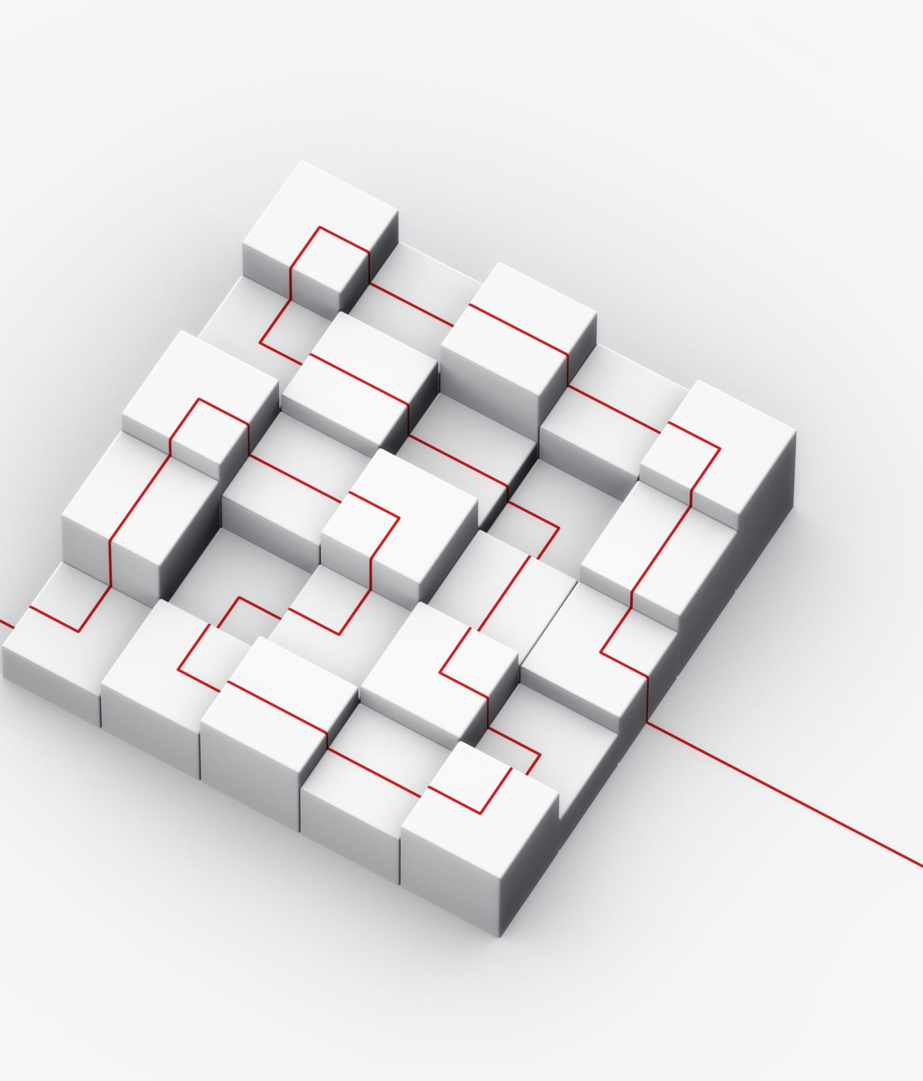
The network model
The proposed network model is a pathogen classifier using convolutional neural networks (CNN). It is designed for the classification of genomic data, specifically one-dimensional genomic sequences.
We started by trying a simple model with only fully connected layer. We improved it to model with one layer of convolution, activation function, pooling layer, and fully connected layer. Finally, we made the following model:
The model consists of several layers including convolutional layers, activation functions, max pooling layers, and fully connected layers.
The model has three convolutional layers: layer1, layer2, layer3 and layer4. The convolutional layers perform convolutions on the input data to extract relevant features. Each convolutional layer is followed by a ReLU activation function to introduce non-linearity. After each activation function, a max pooling layer is applied to reduce the spatial dimensions of the feature maps.
The output from the last convolutional layer is flattened. The flattened tensor is passed through two fully connected layers: fc1 and fc2.
The output from the last fully connected layer is the result (a tensor with dimension of the number of classes).
This model is more accurate and can classify pathogens well and efficiently.

Slide 4
Network Design and Training
We implemented the network using PyTorch, a popular deep learning framework. As we saw, we made a CNN network that consists of several convolutional layers followed by ReLU activation and max-pooling operations, which help extract hierarchical features from the input. The output of the convolutional layers is flattened and passed through fully connected layers to make predictions.
The genomic data is preprocessed before training the network.
The input sequences are encoded and transformed into a suitable format for the network.
The sequences are padded or truncated to a target length to prevent computation problems.
Label encoding is also performed to convert the categorical lineage labels into numerical form for the training.
We divided the data randomly - we took 80% of the data for training and 20% for testing.
The network is trained using a cross-entropy loss function, which is commonly used for multi-class classification problems. In addition, the Adam optimizer is employed to update the model parameters during training.
The training is performed for a fixed number of epochs (30 in our case), with each epoch iterating over the entire training dataset in mini-batches. During each training iteration, the model parameters are updated based on the computed loss and backpropagation.

Slide 5
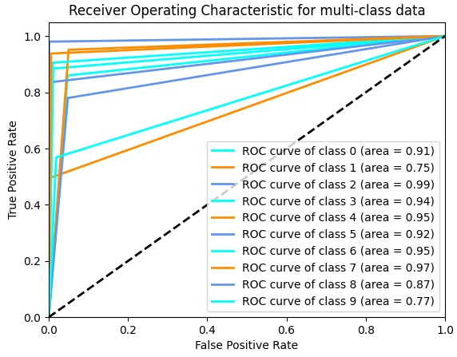
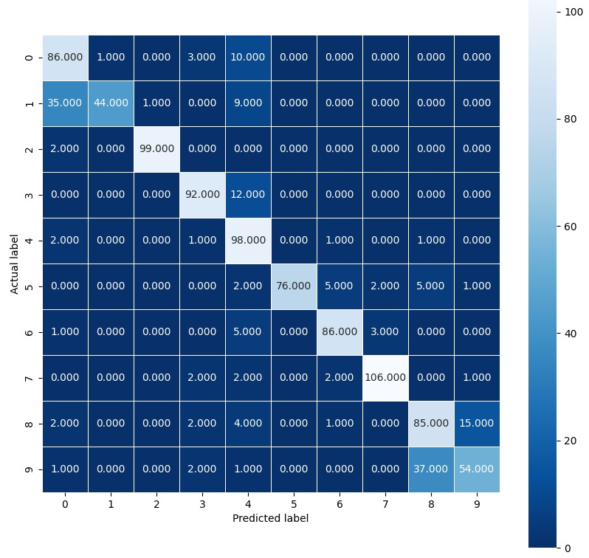
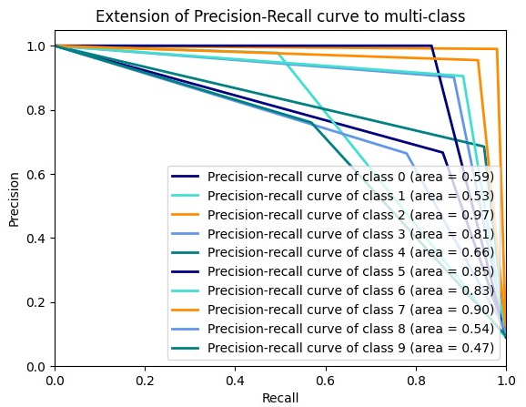
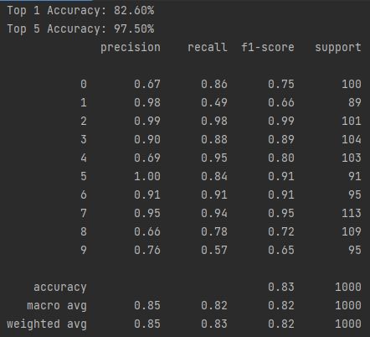
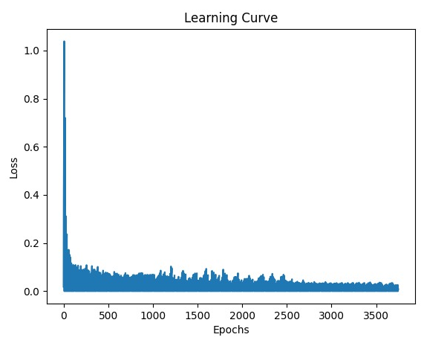
Results and Potential Future Work
For the purpose of running and testing the model, we randomly selected 5,000 data files belonging to 10 different classes of pathogens as inputs. Each file contains a long sequence of characters that represent a specific pathogen.
The inputs are given as FASTA files. Therefore, we found the lineage of each file by the metadata, and we created a csv file with the id and the lineage of each input. Afterwards, we also created encodings for the sequences and the labels.
We ran the code on the training set and we got a classification model. We calculated several evaluation metrics for the obtained model and presented graphs that illustrates the results.
In the continue, we will run the model on larger data, and we will try to improve it further in different ways (for example, by performing additional preprocessing operations).
In the future, we can try to integrate the algorithm with a hardware accelerator, and research the results and the performances.

